Slide 1

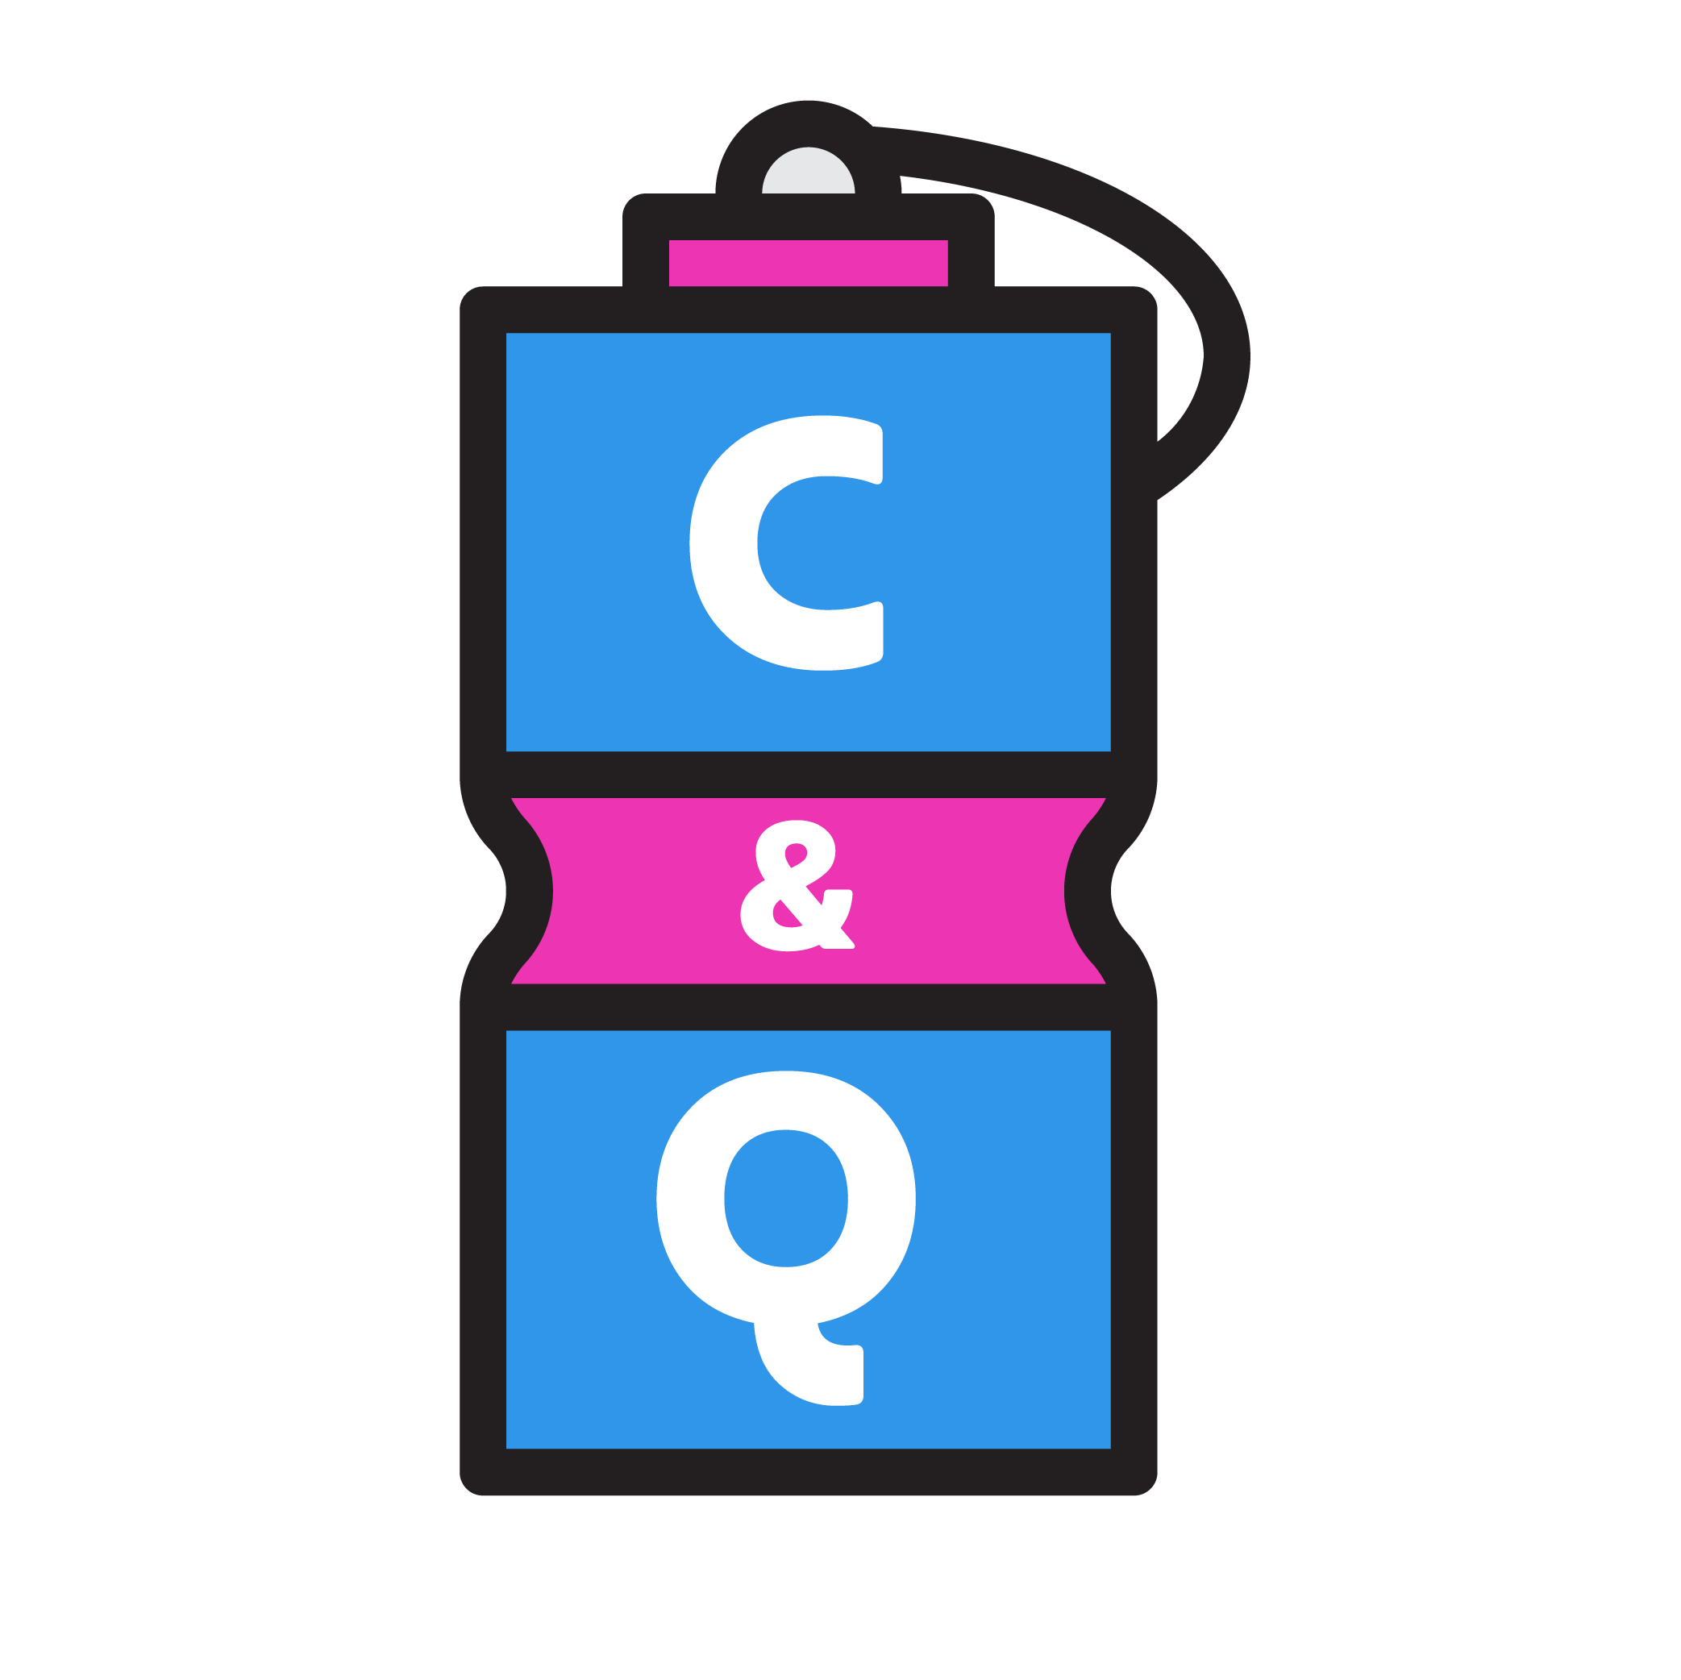
Daraz Selling – Crave & Quench
Samima Khan, Tooba Khalid, Ahsan Siddiqui,
Tayyaba Zubair, Arisha Panjwani

Slide 2
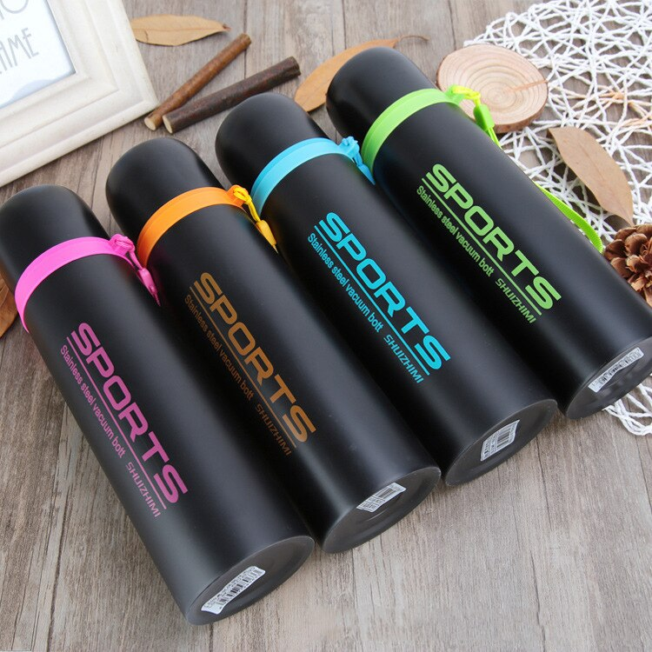
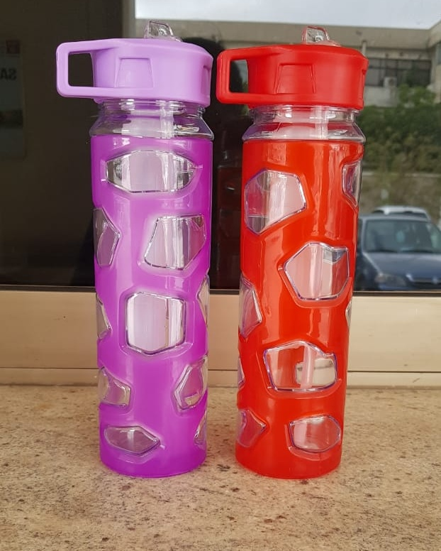

Why these products?
Product
Marketing Mix

Slide 3
Price
Marketing Mix
Market penetration pricing gone wrong!

Slide 4
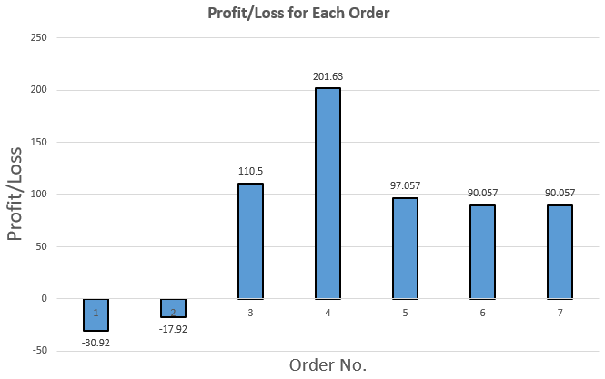

Slide 5
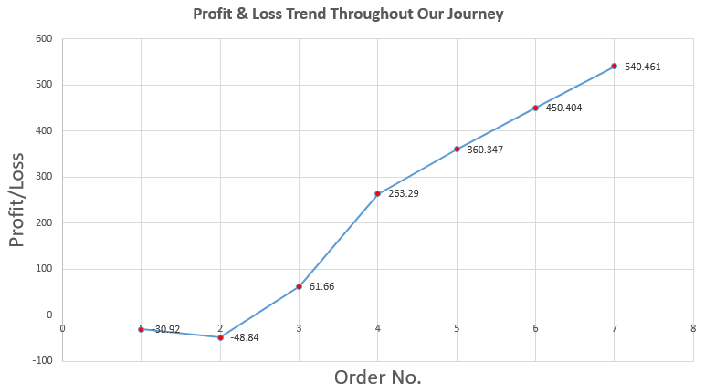
Our final profit
The slope is steepest between the third and fourth order.

Slide 6




Online Product Presence On Multiple Platforms
Place
Marketing Mix

Slide 7
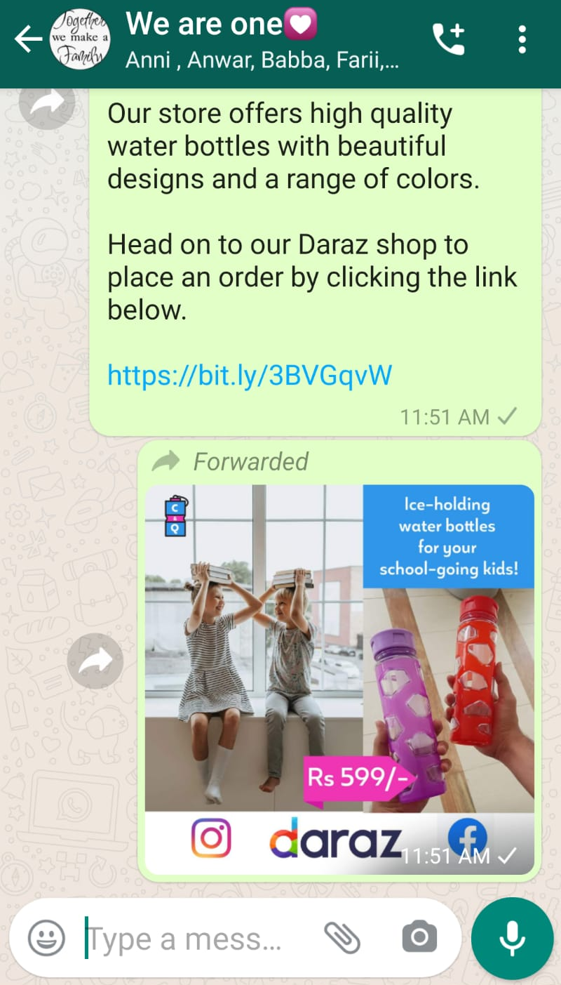
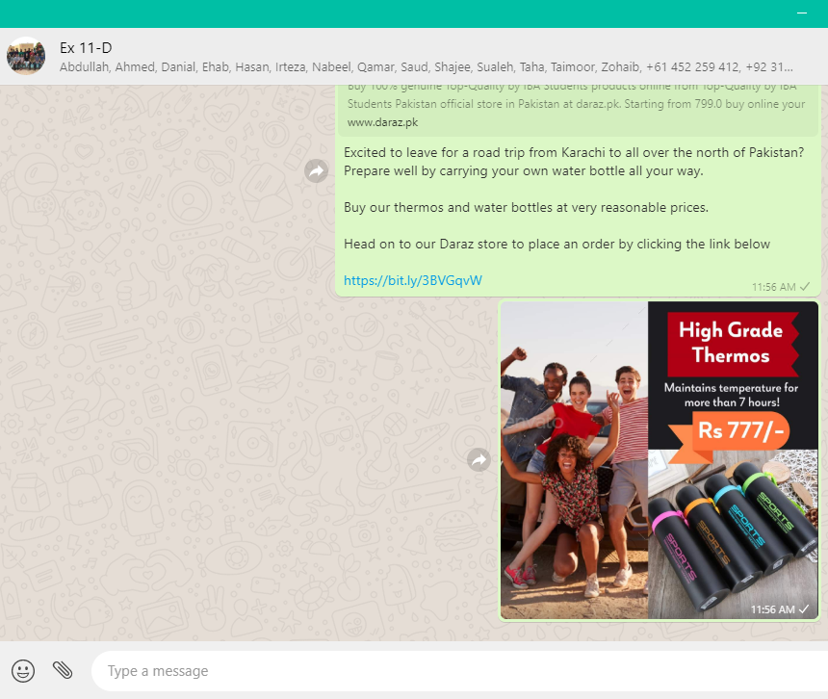
Our Marketing Posts in WhatsApp Groups

Slide 8
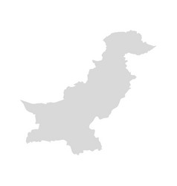

Where did we receive orders from?
Place
Marketing Mix
Hafizabad
1
Ghotki
1
Karachi
5

Slide 9

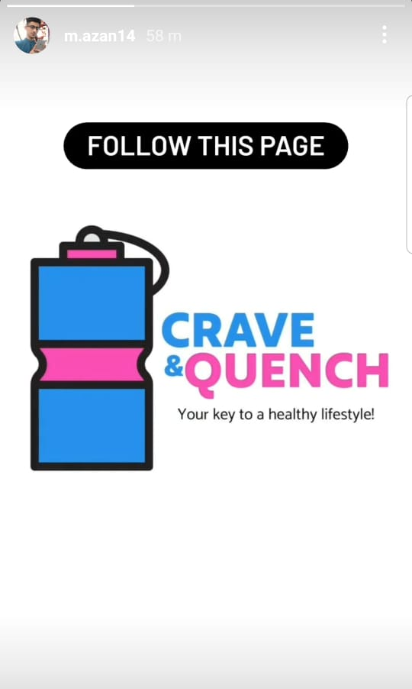

Influencers

Slide 10
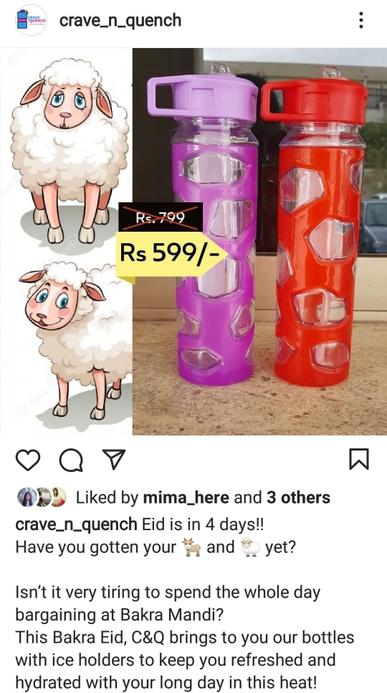
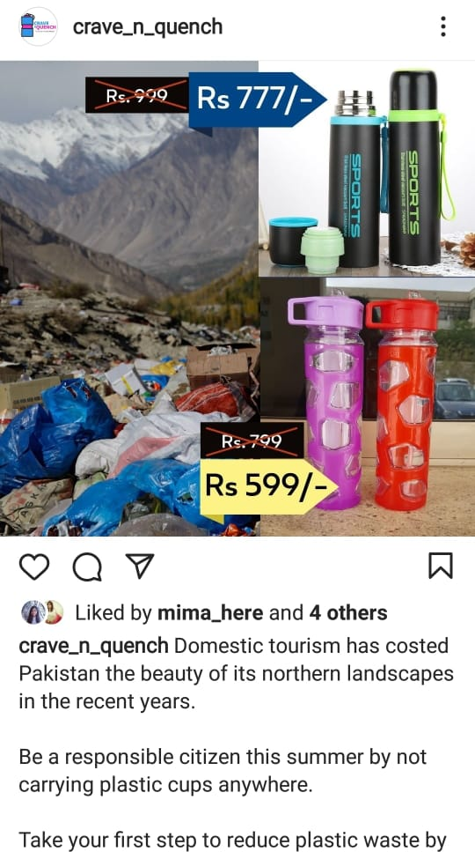
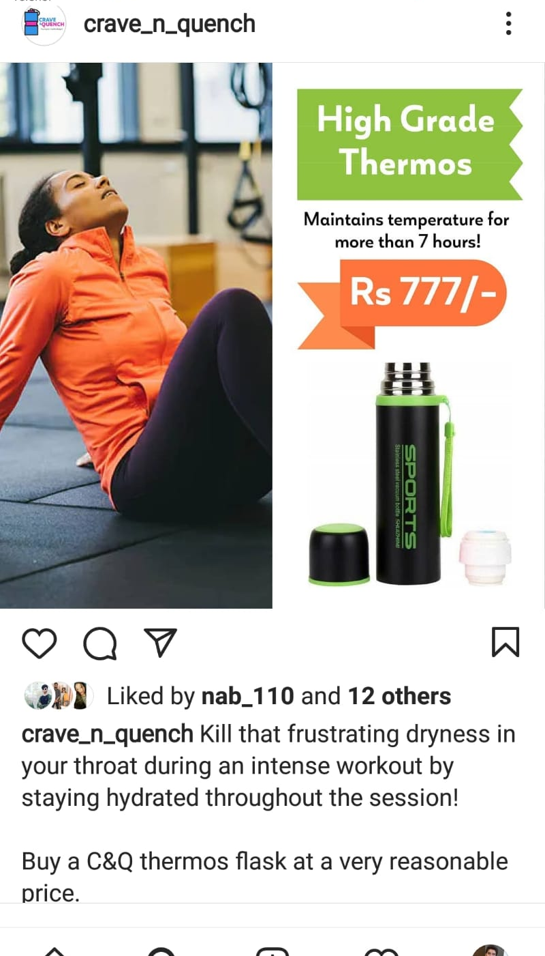
Promotion
Marketing Mix
Occasional Marketing
Sustainable Marketing
Target Marketing

Slide 11
Our Marketing Posts in WhatsApp Groups

Slide 12
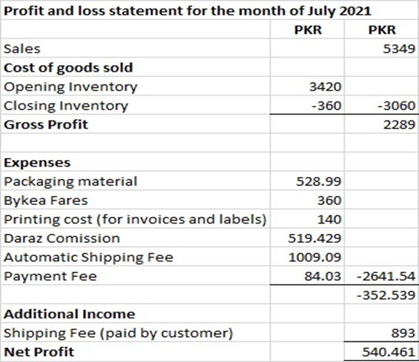
Profit/Loss Report
Sales: Rs. 5349
Gross Profit: Rs. 2289
Total expenses: Rs. 2641.54
Net profit: Rs. 540.461

Slide 13
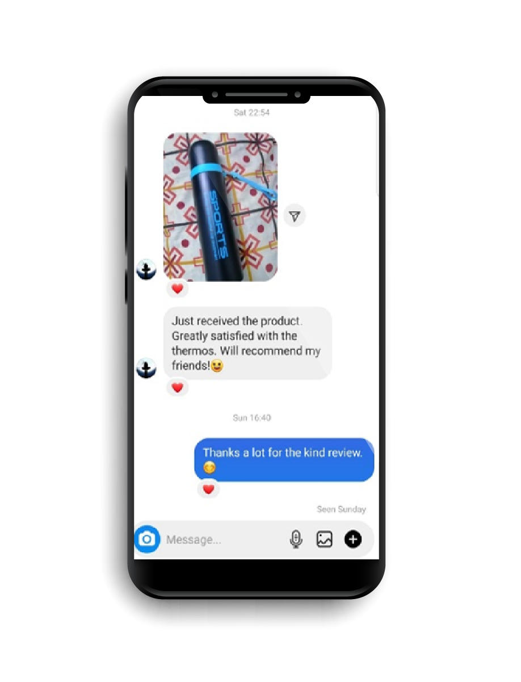
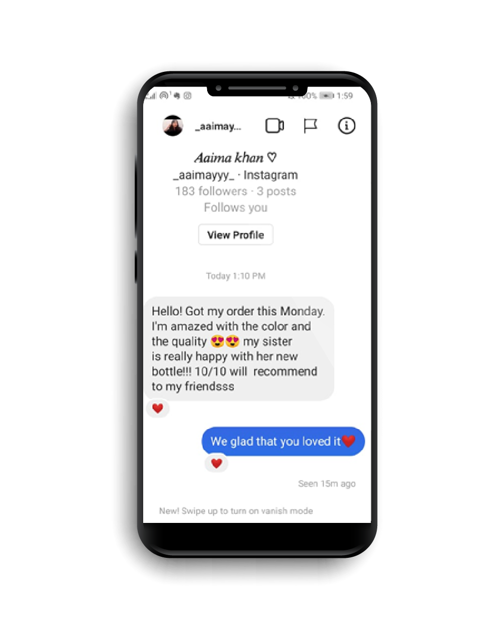
Social Media Reviews

Slide 14
Challenges Faced
Product sourcing and inconsistency
Daraz account verification
Product marketing issues
Pricing and saving issue
Selecting a Courier Service

Slide 15
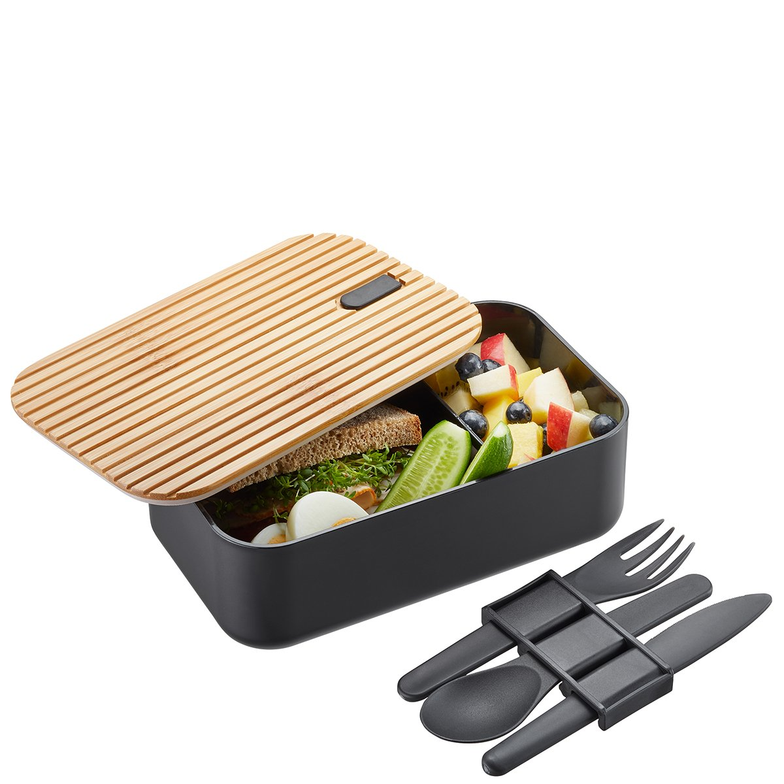

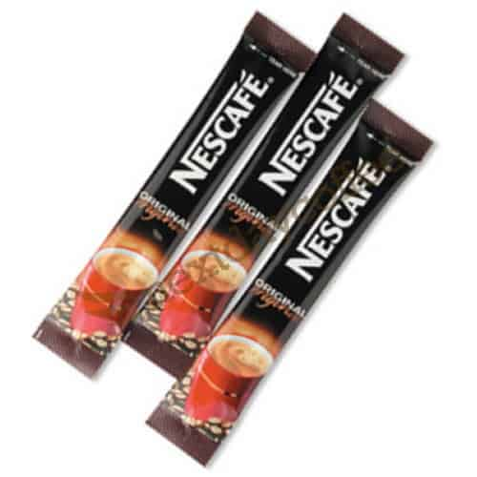

Future Work
Market penetration
Product development
Market development
Diversification

Slide 16
Thank you!

